Slide 1
WELCOME TO
GEN AI
HACKATHON
TITLE PAGE
Problem Statement Title- AI COLLEGE COMPLAINT BOT
Theme-” AI Driven platform for Transparent and Efficient complaint handling”
PS Category- Software
Team Name- CAMPUSMIND AI
Team Member-
Astha pandey(Team lead)
Divyanshu Maurya

Slide 2
PROBLEM STATEMENT-
Inefficient college complaint handling system
CampusMind AI
Purpose / objective: Highlight the issues students and administration face with the current manual complaint management process.
Problem (detailed):
In many colleges, complaint registration and resolution are done manually — through paper forms, emails, or in-person communication.
Students often hesitate to report issues due to lack of transparency or fear of delayed/no response.
Administrative departments struggle with tracking and prioritizing complaints efficiently.
There is no centralized system to store complaint data, making it hard to analyze recurring issues or ensure accountability.
Miscommunication between students and staff leads to unresolved grievances and reduced trust in the system.
Lack of real-time updates leaves students unaware of the progress of their complaints.

Slide 3
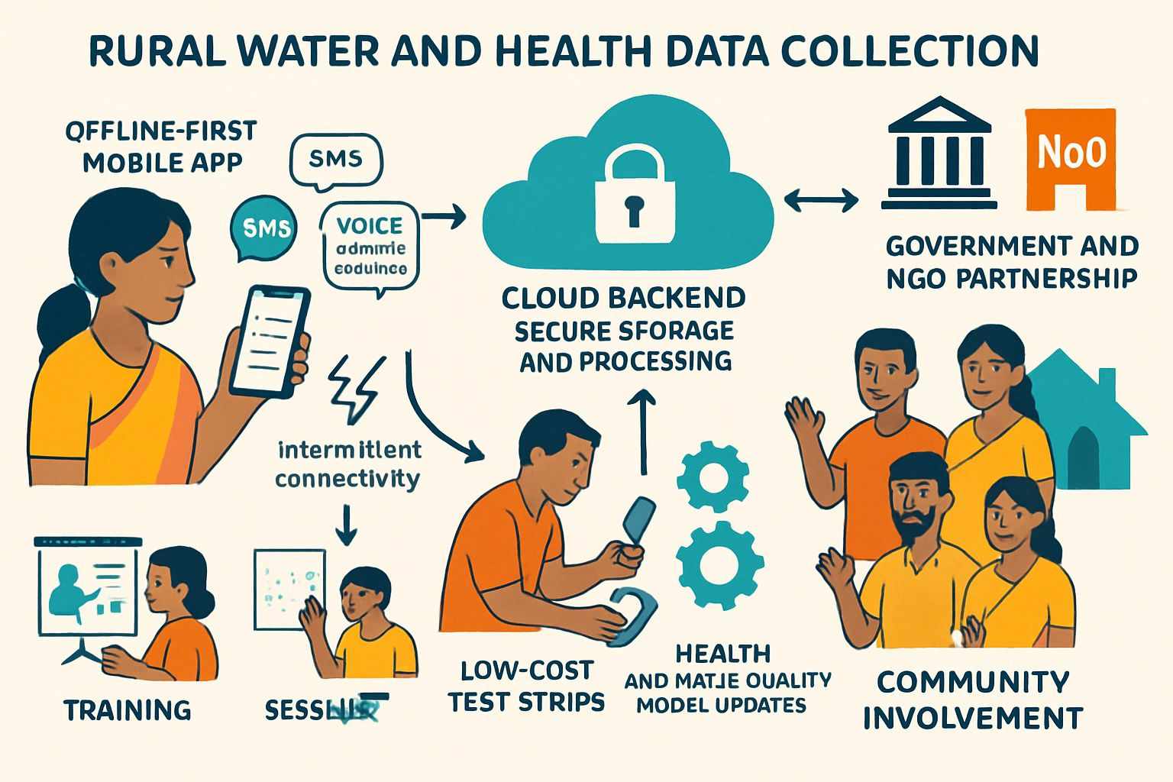
Proposed Solution
.
.
Developed an AI-powered complaint management platform for colleges.
Students can easily register, track, and manage complaints through a web-based interface.
Students can easily register, track, and manage complaints through a web-based interface.
Integrated Gemini API to analyze and categorize complaints intelligently.
Python backend securely stores and forwards complaints to respective authorities.
Ensures transparency, faster response, and reduced manual workload for administration.

Slide 4
Technical Approach –
Frontend:Technology Used: React.js
Description:
Developed a responsive and interactive user interface using React.js.
Utilized React Hooks and Component-Based Architecture for efficient state management and modularity.
Integrated API endpoints to dynamically fetch and display data from the backend.
Ensured smooth navigation and user experience through React Router.
Backend:Technology Used: Python (Flask 2.5) with Gemini API
Description
Designed a lightweight and scalable backend using Flask 2.5.
Implemented RESTful APIs for communication between frontend and backend.
Integrated Gemini for AI-driven functionalities and intelligent data processing.Handled data validation, request routing, and server-side logic efficiently.
Integration & Deployment:
Established seamless communication between React frontend and Flask backend using HTTP/JSON APIs.Tested all endpoints using Postman to ensure reliability and security.

Slide 5
Architecture/Design
🧑‍🎓 Student Side (Frontend)
Fills out complaint form → clicks submit
Data + text sent to backend
🧠 AI Layer (Gemini API)
Analyzes the complaint text
Categorizes & summarizes it
🐍 Backend (Python)
Connects frontend and database
Saves the complaint + AI result to Firebase🗄
Database (Firebase Realtime DB)
Stores complaint records securelyAllows admin-only data access
👨‍💼 Admin Dashboard
Fetches all complaints
Shows Gemini-generated summaries (Top issues, etc.)
Helps admin track and act quickly

Slide 6
Demo
Youtube link –
https://youtu.be/Kv2a5v5s1FY?si=gltC-zURmcm99ejS
"Let’s see how our AI College Complaint System works.First, the user visits the homepage where they can see the option to submit a new complaint.Here, the student enters their details like name, email, and complaint description.
Once they click on ‘Submit’, the data is sent to the backend built using Python.Our Gemini API analyzes the text, understands the type of issue, and categorizes it — like technical, hostel, or academic.
After that, the complaint is automatically stored in the database and forwarded to the right department.Admins can log in to view all complaints, their status, and AI-generated summaries for quick action.
Finally, the student can also check the status of their complaint — whether it’s pending, in progress, or resolved.
So this is how our AI-powered system makes the complaint process faster, smarter, and more transparent.”

Slide 7
IMPACT AND USE CASES
IMPACT-
Transparency: Ensures that every complaint is tracked, verified, and resolved fairly.
Time Saving: Automates the complaint sorting and forwarding using Gemini AI, reducing manual workload for admins.
Student Empowerment: Gives students a voice to raise issues easily without fear or bias.
Efficiency: Real-time alerts and categorized complaints allowdepartments to act faster.
Smart Insights: AI analytics can detect repeated issues (e.g., “water cooler not working”) and highlight problem trends.
Sustainability: Moves the complaint process from paperwork to digital—eco-friendly and efficient.
USE CASES-
Hostel Issues:Students can report hostel maintenance or food quality issues. The system routes them to the hostel warden automatically.
Classroom Problems:AI detects keywords like “projector,” “fan,” “bench” and forwards to the maintenance department.
Harassment or Misconduct Reports:Sensitive complaints are sent securely to a special admin or counselor without revealing the student’s identity.
Faculty Feedback:AI summarizes frequent faculty-related complaints to improve teaching quality.
Technical Issues:Complaints about online portals, Wi-Fi, or lab PCs are directly sent to the IT department.

